Slide 1

Time Series

Slide 2

Contents
Why Time Series
Regression on Time
Auto-Regressive Models
ACF and PACF
Simple Moving Average
Weighted Moving Average
Exponential Smoothing
Holt-Winters Method
ARIMA
03

Slide 3

What is Time Series Data?
A sequence of data points in successive order, indexed by time.
y_{t} y_{t-1}, y_{t-2}, y_{t-3, ….}
Population of the country listed year-wise
Temperature in the city listed by the hour
Number of iPhones sold listed for each quarter
03

Slide 4
Forecasting
Factors to forecast Tata Motors
Current Price
Current Sales
Sales Trend
Competition
Company growth
Exchange Rate
Tax rates
Cost of Production
03

Slide 5

Typical Time Series
𝑦 _{𝑡+1} = 𝑓 (𝑡, 𝑦_{𝑡}, 𝑦_{𝑡−1}, 𝑦_{𝑡−2} …)
𝑓 can be linear or nonlinear function
Time series forecasting attempts to do same forecast just using the past data of 𝑦, without relying on any other external predictors (𝑥_{𝑖}).
03

Slide 6

Why Time Series
Casual Independent Variables are:
Unknown to us
Not Available
Might not fit the data well
Difficult to forecast
Notes:
Often difficult to predict with all the data we have
Stock changes every hour even when gdp and all remain same
May be the effects of all the parameters have resulted the previous price and now
There is no way to predict accuractly just by time series
We are just assuming that when we have no other data then how much can we predict my time series

Slide 7
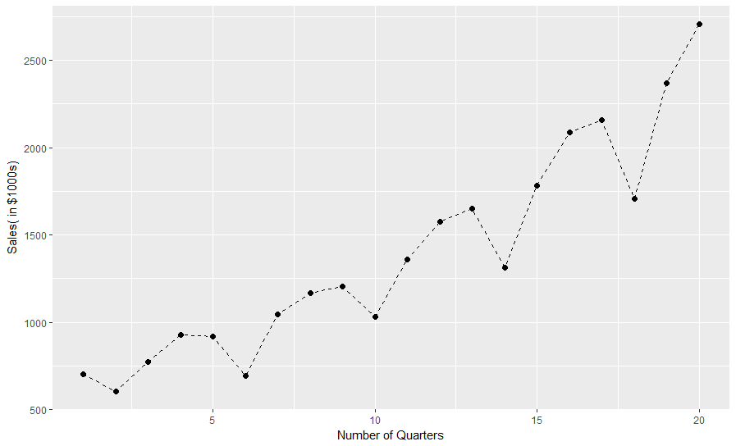
Regression with time: Seasonality
03

Slide 8
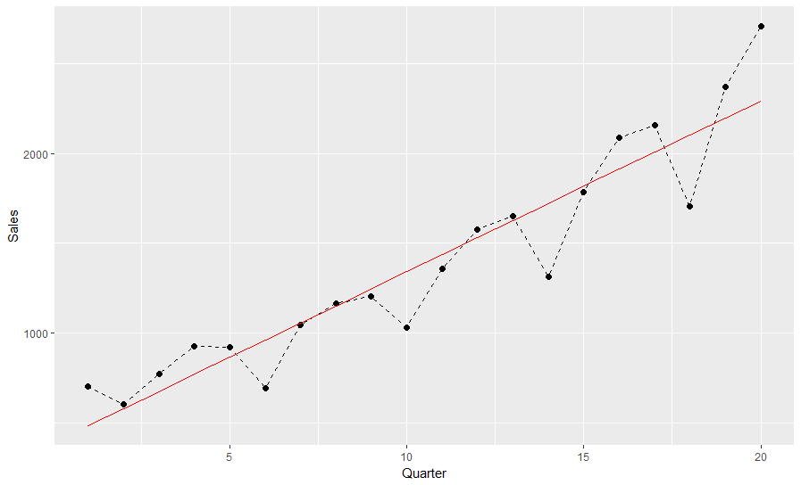
Linear Fit
03
Notes:
Simple linear fit and errors are high

Slide 9
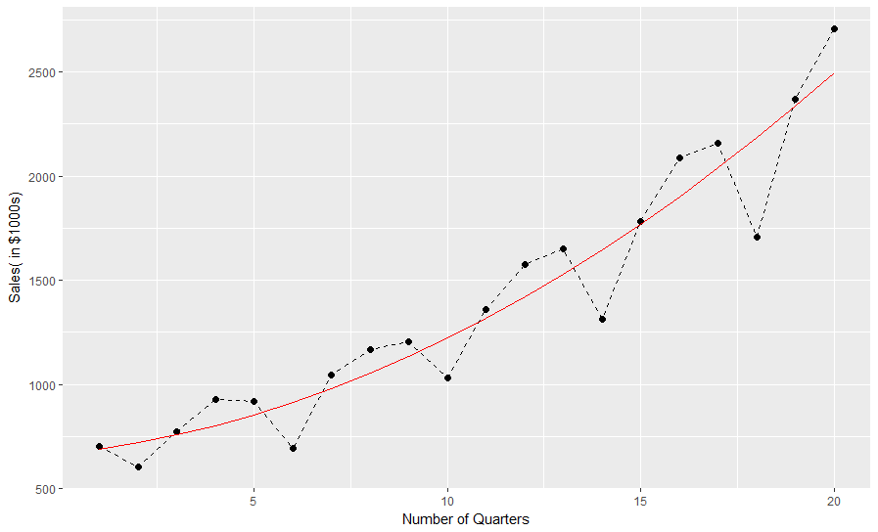
Quadratic Trend
03
Notes:
Trying the quadratic trend and this is better than linear but still it doesn’t explain the features
It is missing the local variation and every fourth quarter is it lower than we predict this is called seasonal variation and we often see in most business
Even the overall trend is increasing the fourth quarter is lower than first
So we are missing this pattern just by seeing the trend and we are missing the variation through quarters and think of feature engineering
Add categorical variable for quarter

Slide 10
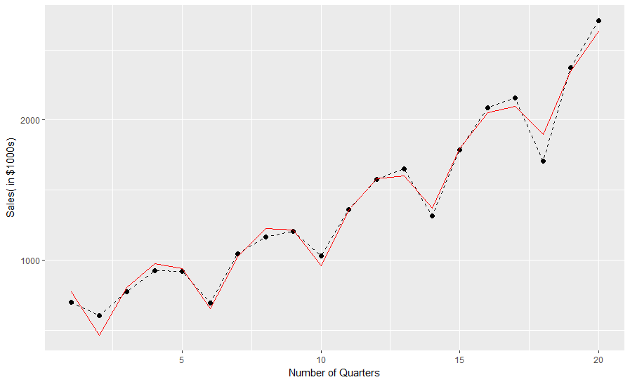
Seasonal Regression Model
Quarter | X_{3t} | X_{4t} | X_{5t}
1 | 1 | 0 | 0
2 | 0 | 1 | 0
3 | 0 | 0 | 1
4 | 0 | 0 | 0
where, X_{1t}= t and X_{2t}= t².
03
Notes:
This is a linear fit and all that is done is taking quarter data
By taking separate quarter data I am basically fitting separate quadratic line for each quarter.
The time is fixed and I am adding dummy variable which pops up for respective quarter..
This is called seasonality

Slide 11
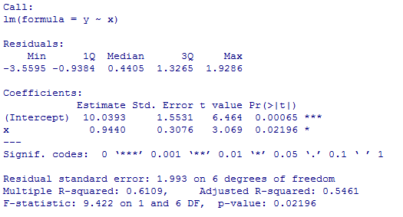
Simple Case
Year | Quarter | Time variable | Revenues (in $M)
2008 | I | 1 | 10.2
 | II | 2 | 12.4
 | III | 3 | 14.8
 | IV | 4 | 15
2009 | I | 5 | 11.2
 | II | 6 | 14.3
 | III | 7 | 18.4
 | IV | 8 | 18
𝑦 = 10.0393 + 0.9440t
03
Notes:
Use this simple and predict the values

Slide 12
Seasonality: Multiplicative
Time | Observed values(TSI) | Predicted values (T) | SI* = TSI/T
1 | 10.2 | 10.983 | 0.929
2 | 12.4 | 11.927 | 1.040
3 | 14.8 | 12.871 | 1.150
4 | 15.0 | 13.815 | 1.086
5 | 11.2 | 14.759 | 0.759
6 | 14.3 | 15.703 | 0.911
7 | 18.4 | 16.647 | 1.105
8 | 18.0 | 17.591 | 1.023
* T: Trend; S: Seasonal; I: Irregular
03
Notes:
Now do a seasonal correction factor
Predicted is 92.9% the actual value

Slide 13
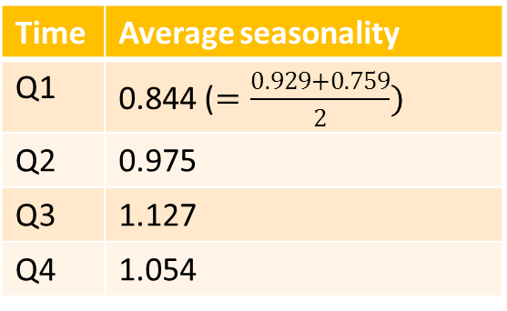
Quarterly Seasonality
Time | Average seasonality
Q1 | 0.844 ($=\frac{0.929+0.759}{2})$
Q2 | 0.975
Q3 | 1.127
Q4 | 1.054
• Trend Y₉=10.039 + 0.944(9) = 18.535
Corrected for seasonality and
randomness: 18.535 * 0.844 = 15.643
Time | Observed values(TSI) | Predicted values (T) | SI* = TSI/T
1 | 10.2 | 10.983 | 0.929
2 | 12.4 | 11.927 | 1.040
3 | 14.8 | 12.871 | 1.150
4 | 15.0 | 13.815 | 1.086
5 | 11.2 | 14.759 | 0.759
6 | 14.3 | 15.703 | 0.911
7 | 18.4 | 16.647 | 1.105
8 | 18.0 | 17.591 | 1.023
03

Slide 14
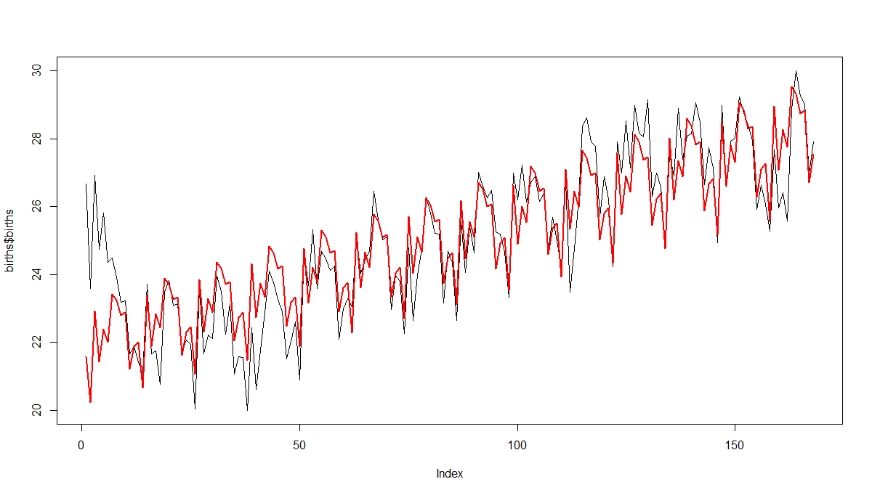
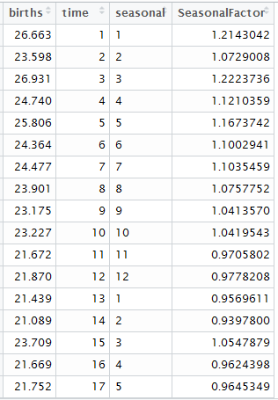
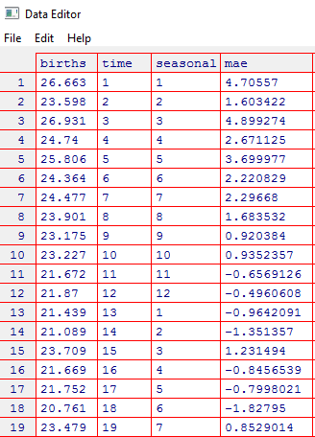
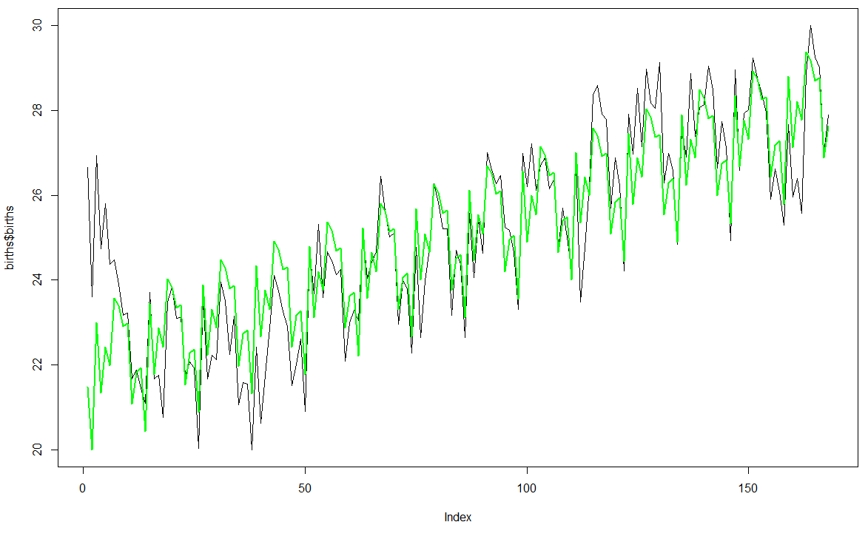
Seasonality: Multiplicative
03
Notes:
If data shows seasonality with more or less constant in amplitude you go with additive seasonality
If variations are rising i.e changing with time and level then go with multiplicative
In real life you will encounter multiplicative seasonality

Slide 15

Goodness of Fit
MSE (Mean square error)
MAE (Mean absolute error)
RMSE (Root mean square error)
MAPE (Mean absolute percent error)
NMSE (Normalized mean square error)
NMAE (Normalized mean absolute error)
NMAPE (Normalized mean absolute percent error)
03
Notes:
Mse vs mape
Why mape over mse it is a time series and the change in level should be appropriate to your prediction and hence we’ll go with mape

Slide 16

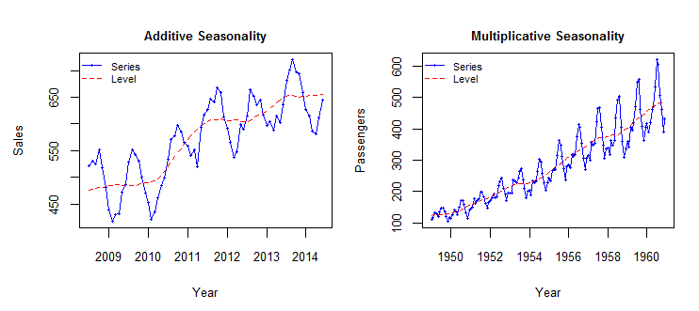
Issues with Regression on Time
It is too much of a curve fit for a statistician to sleep well..
If there is no trend or if seasonality and fluctuations are more important than trend, then the coefficients behave weirdly
03
Notes:
Regression using just time works on just few situation and limited set of situations repeated set of circumstances
Now lets have a look at Auto regressivemethods

Slide 17
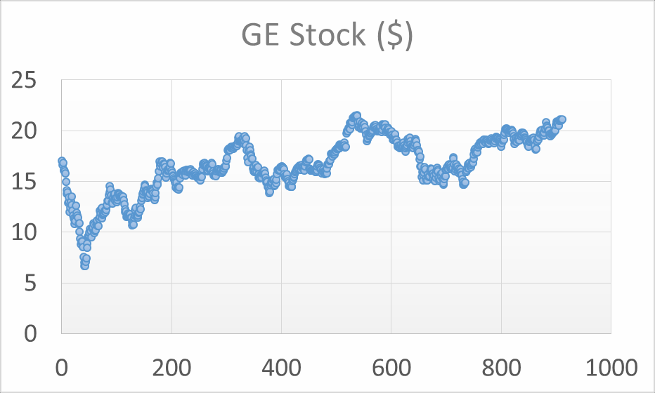

Identifying Techniques for Different Processes
We use different techniques for different processes
Trend
Seasonality
Random stationary
First we need to identify them
03

Slide 18
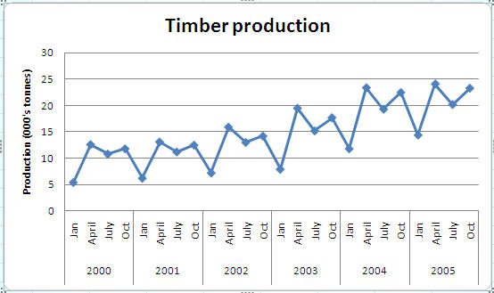
Seasonality
03

Slide 19
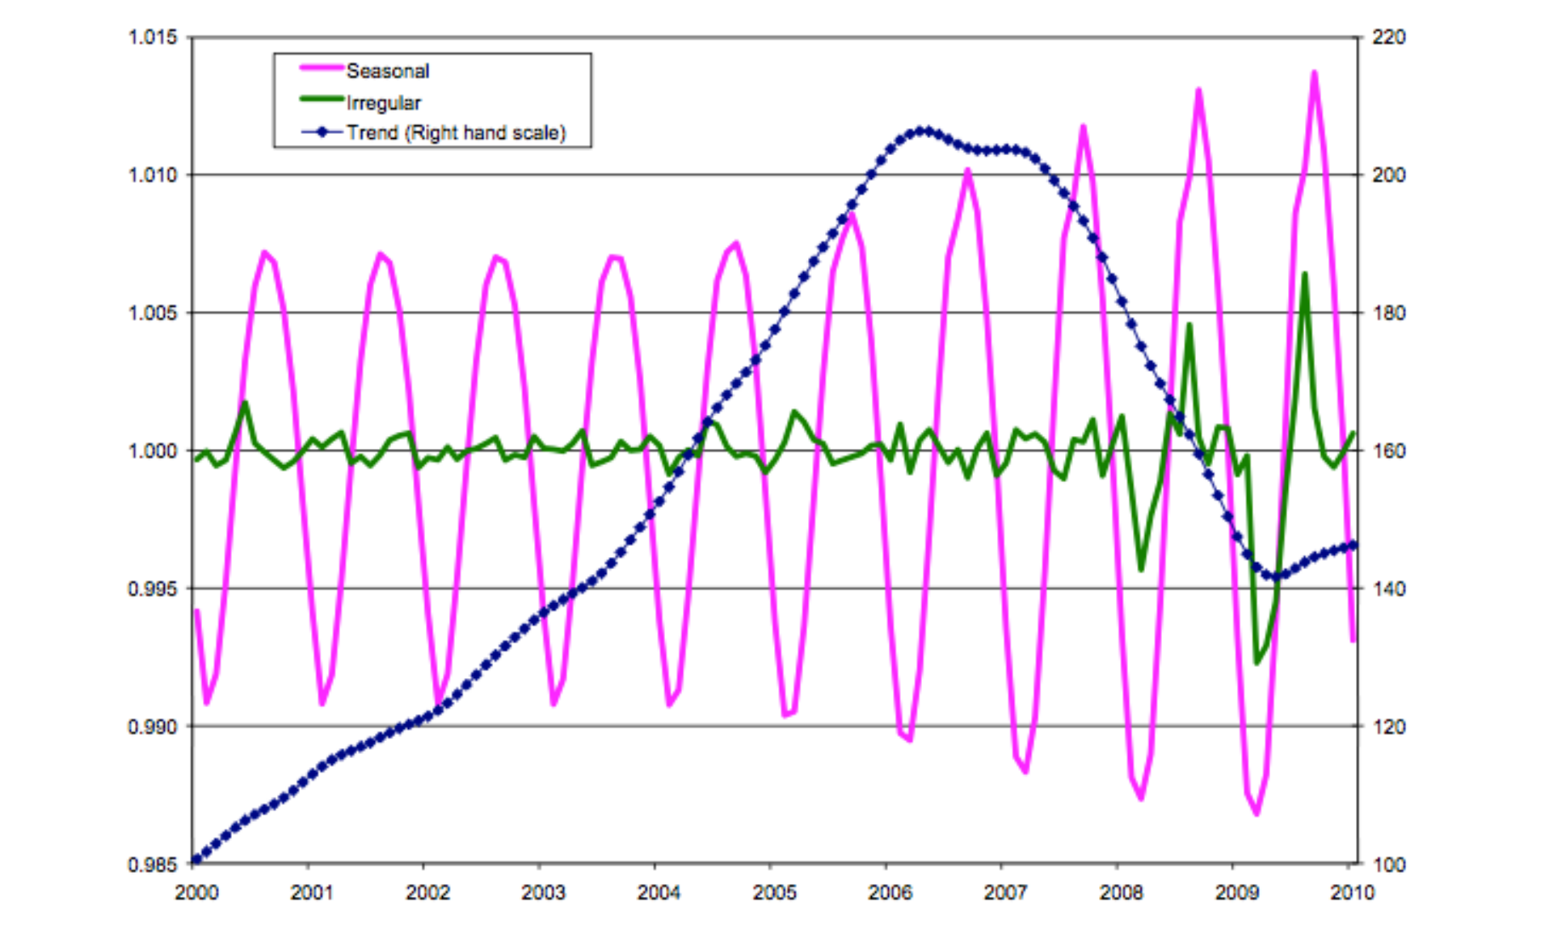
Trend, Seasonality and Randomness
03

Slide 20
Autocorrelation and partial autocorrelation
We use different techniques for different processes
Random stationary
Seasonal
Trend
In descriptive statistics covered earlier (central tendencies, measures of variability, skewness, kurtosis, distributions, correlations, etc.), the order of observations in the data was of no consequence.
In time series descriptive statistics, order of observations is of primary importance and so autocorrelations, etc. play a vital role in identifying the models and their characteristics.
03

Slide 21
Autocorrelation (ACF) and Partial ACF (PACF)
ACF: n^{th} lag of ACF is the correlation between a day and n days before that.
PACF: The same as ACF with all intermediate correlations removed. It is the k_{th} coefficient of the ordinary least squares regression.
𝑦_{𝑡}
𝑘
= 𝛽₀ + _{𝑖=1} 𝛽_{𝑖} 𝑦_{t−𝑖}
where
𝑦_{𝑡}
is the input time series, k is the lag order and 𝛽_{𝑖} is the i_{th}
03

Slide 22
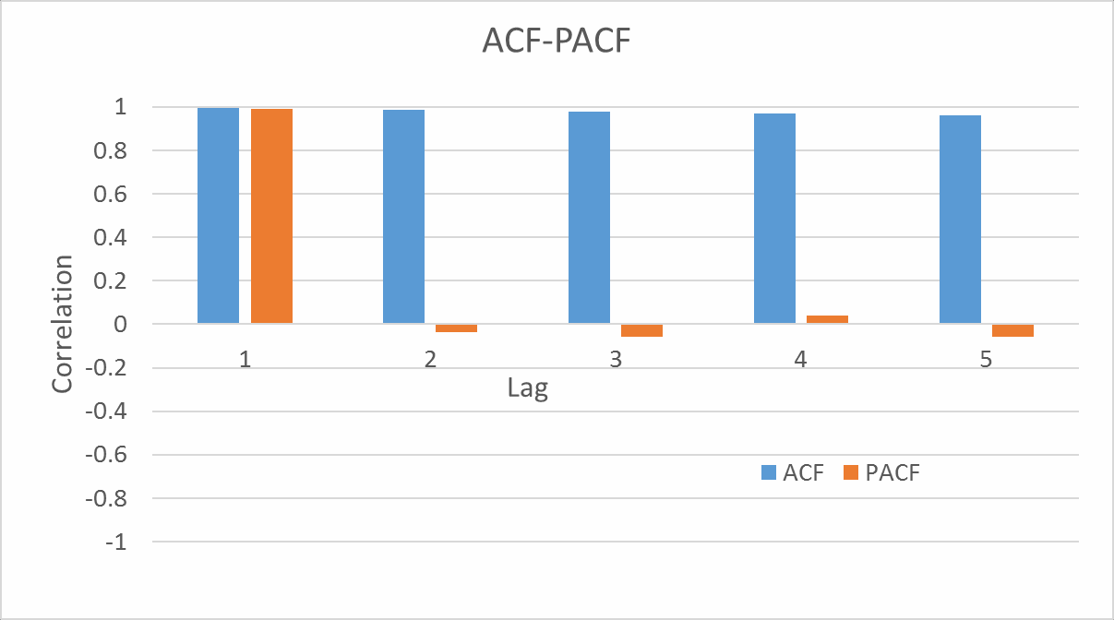
Autocorrelation (ACF) and Partial ACF (PACF)
03

Slide 23
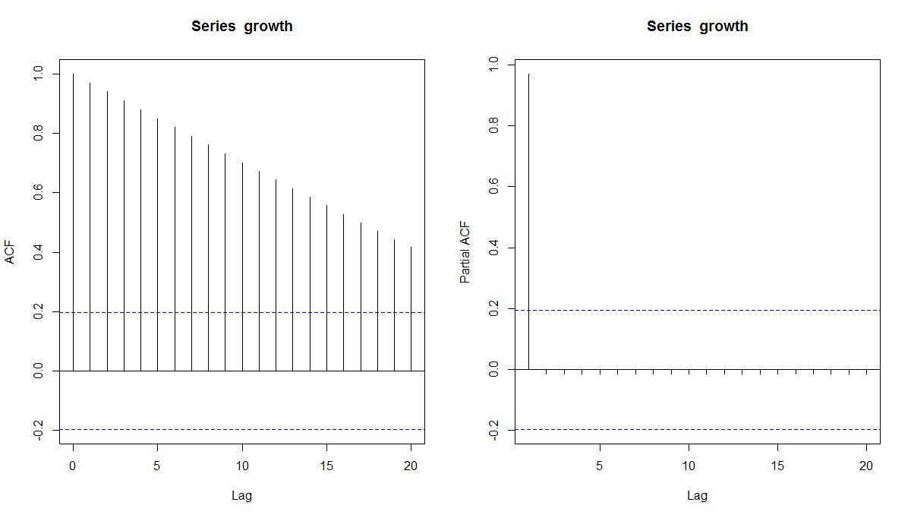
ACF and PACF – Idealized Trend
95% CI: 0 ±1.96/√n
ACF is a bar chart of correlation coefficients of the time series and its
lags.
PACF is a plot of the partial correlation coefficients of the time series and its lags.
03

Slide 24
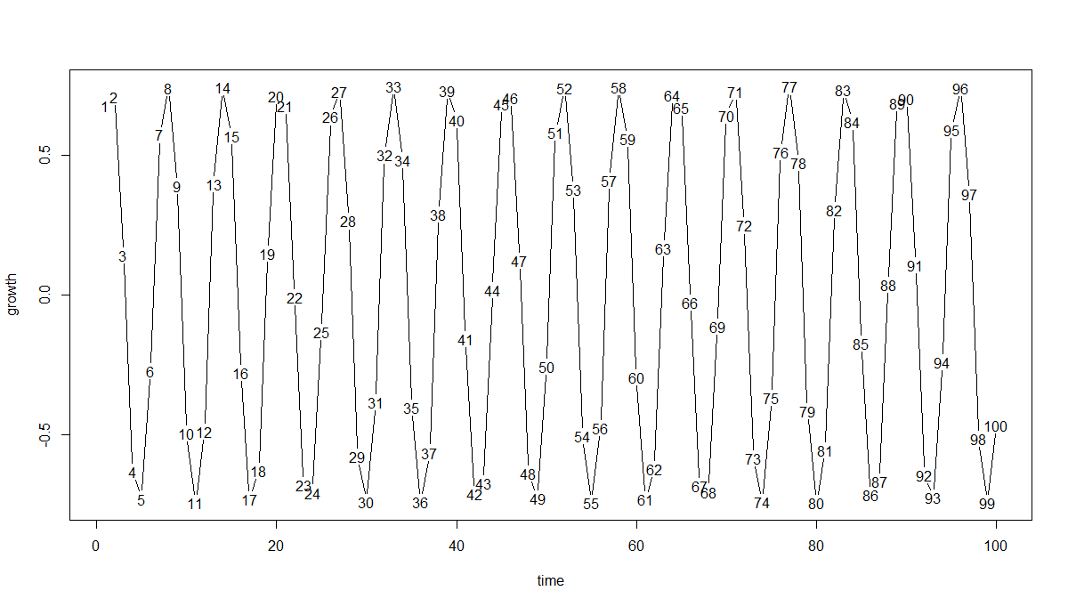
ACF and PACF – Idealized Seasonality
03

Slide 25
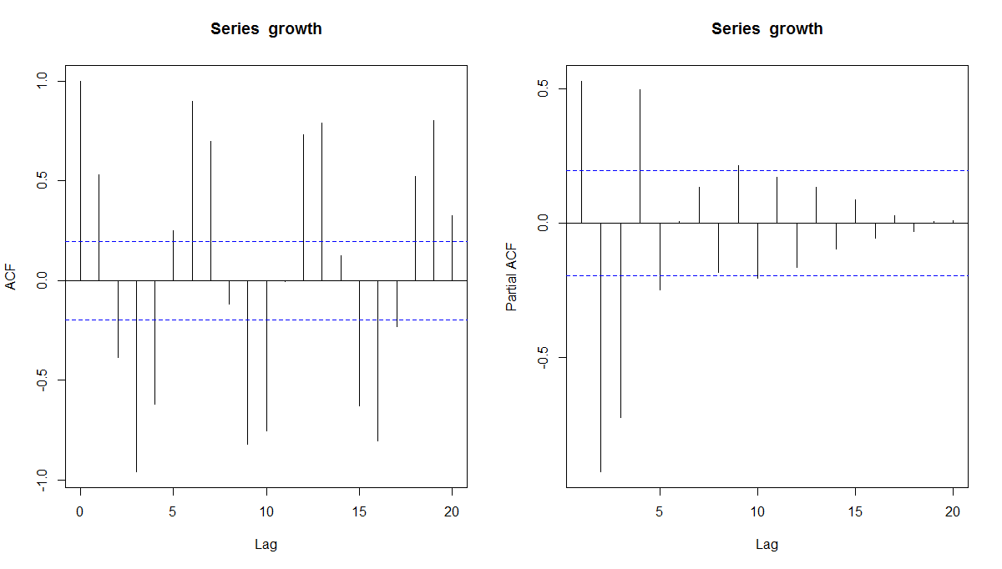
ACF and PACF – Idealized Seasonality
Ideal Seasonality: Cyclicality in ACF and a few lags of PACF with some positive and some negative
03

Slide 26
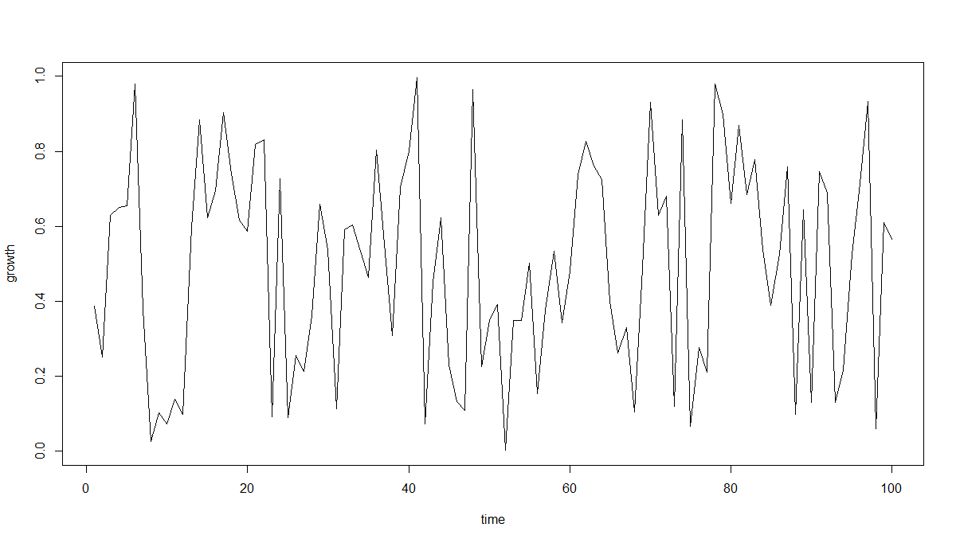
ACF and PACF – Idealized Randomness
03

Slide 27
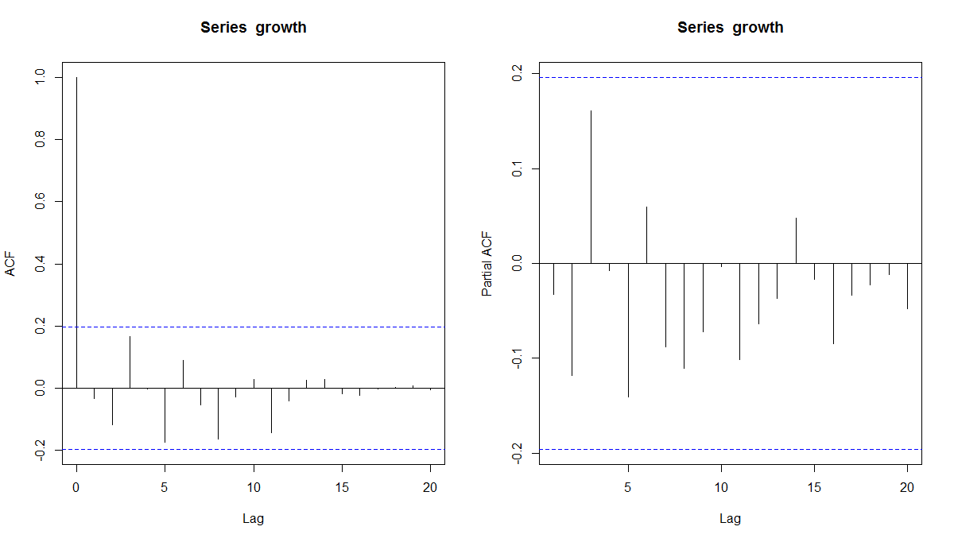
ACF and PACF – Idealized Randomness
Ideal Random: A spike may or may not be present; even if present, magnitude will be small
03

Slide 28
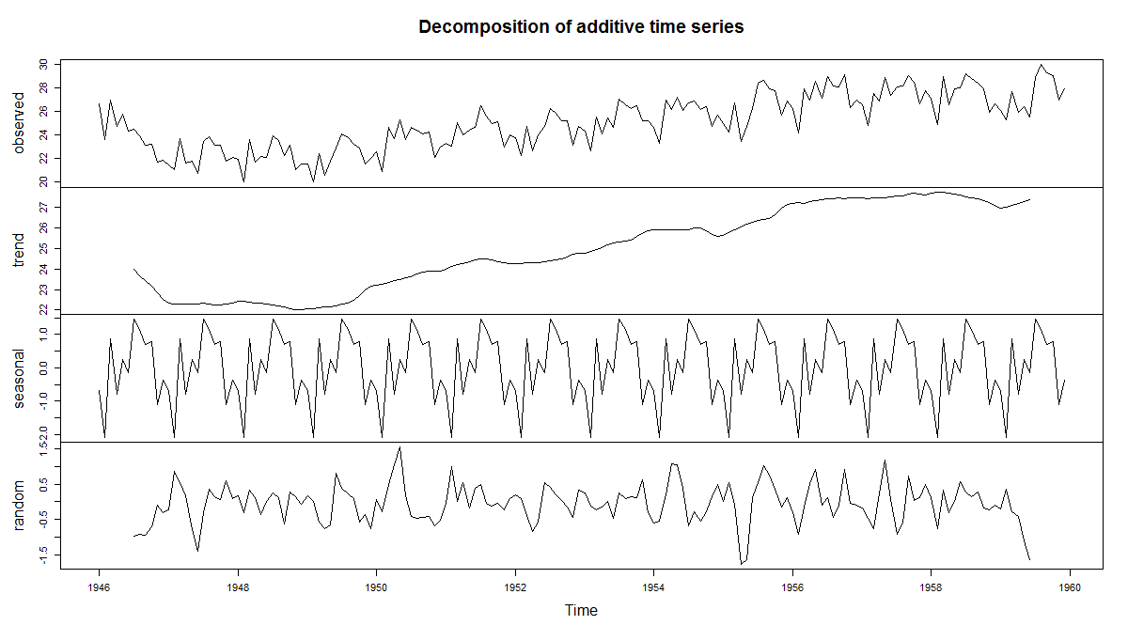
Births in NY
03

Slide 29
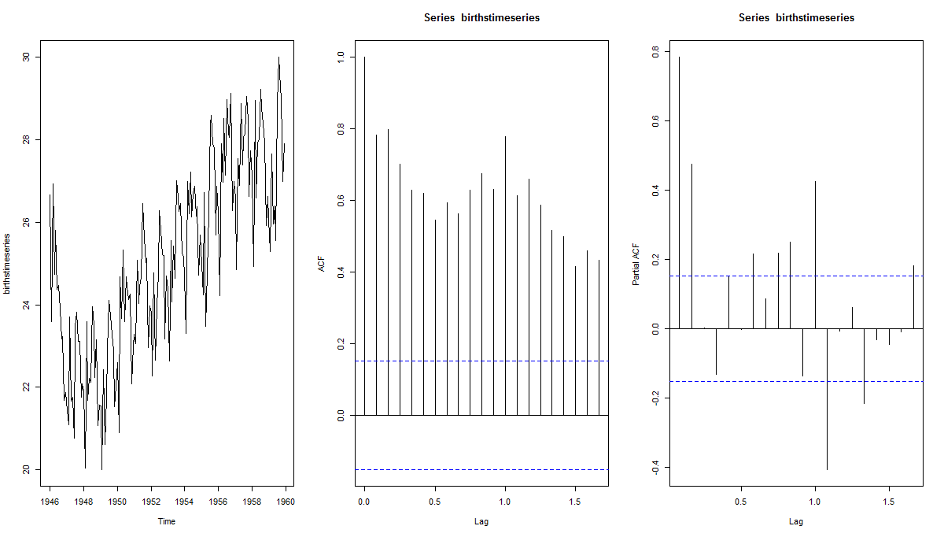
ACF and PACF
03

Slide 30
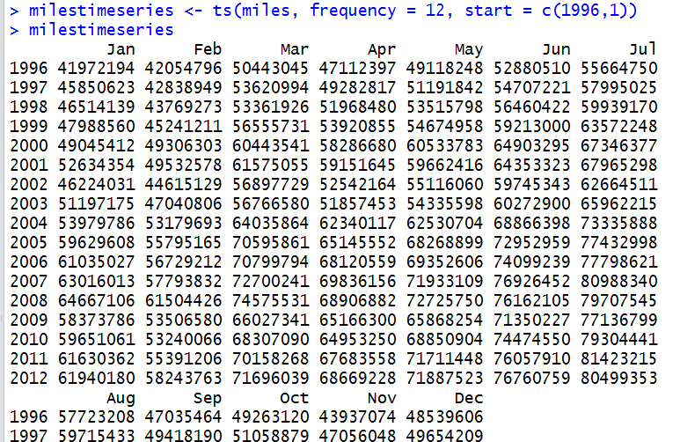
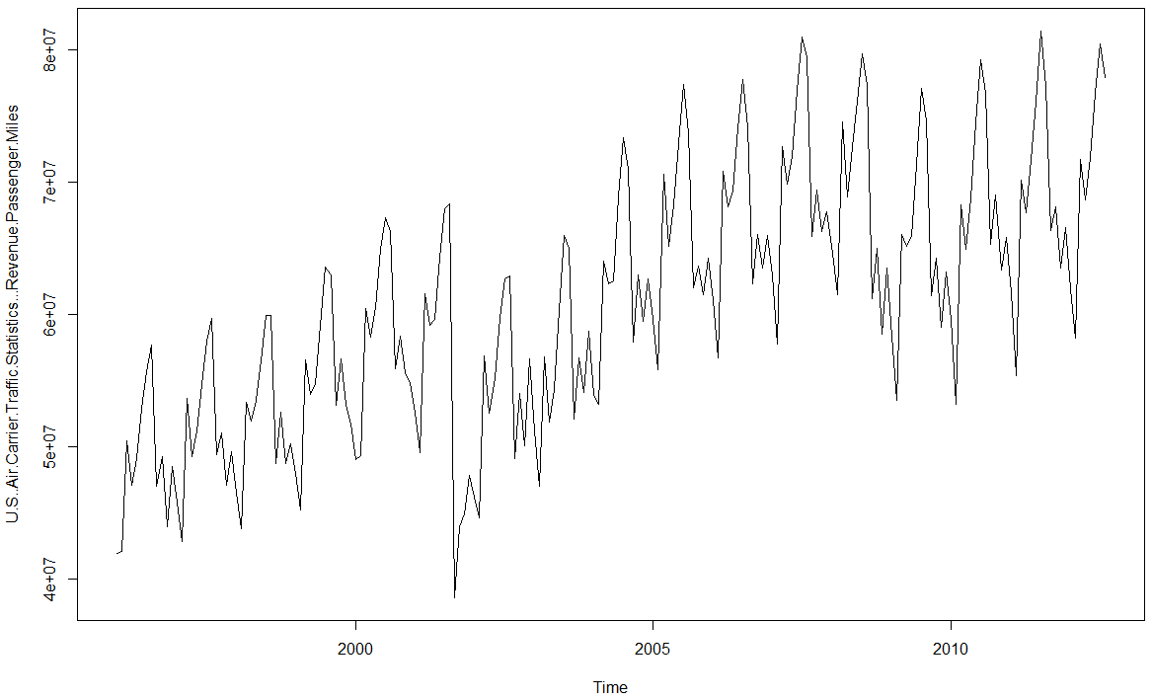
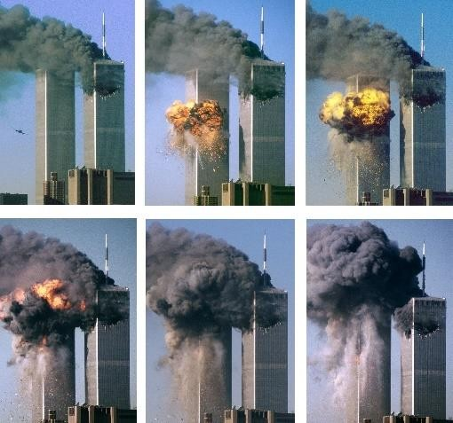
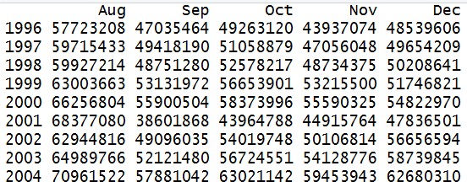
US Air Carrier Traffic – Revenue Passenger Miles
03

Slide 31
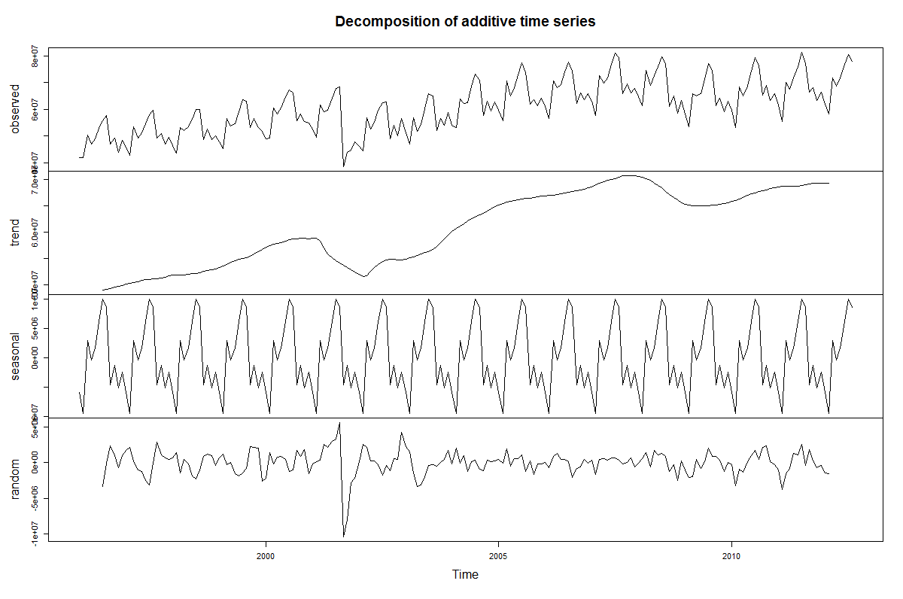
Decomposing
03

Slide 32
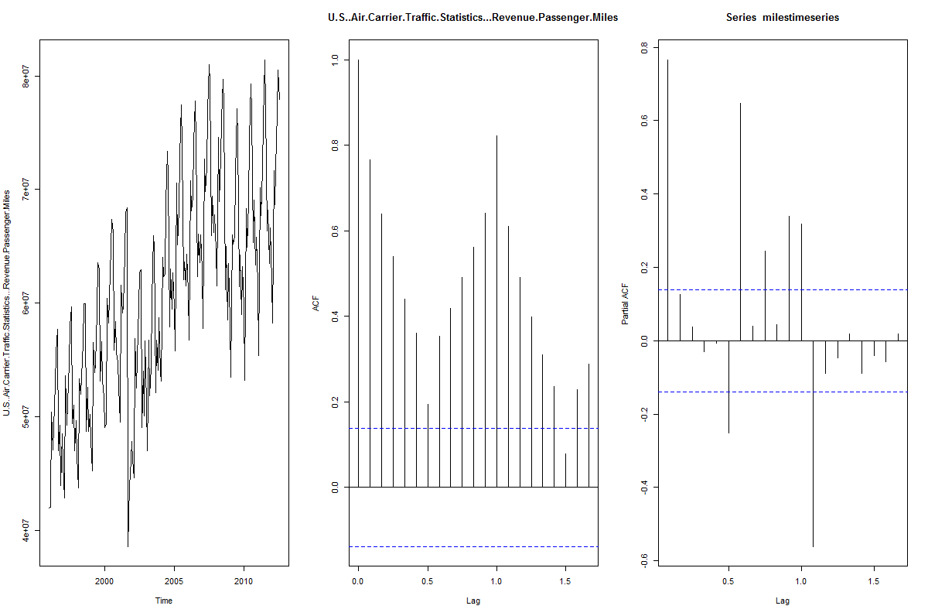
ACF and PACF
03
Notes:
No nice smooth decrease it is not trend that is dominating may be economy and periodicity might be the reason

Slide 33
Stationary and Non-Stationary
Stationary data has constant statistical properties –
mean, variance, autocorrelation, etc. – over time
If the data is stationary, forecasting is easier!
Differencing to convert non-stationary to stationary
03
Notes:
To forecast it is good to have stationary than to have trend in it
To explain things more than just trend then it is good to remove trend and see the remaining data and forecast

Slide 34
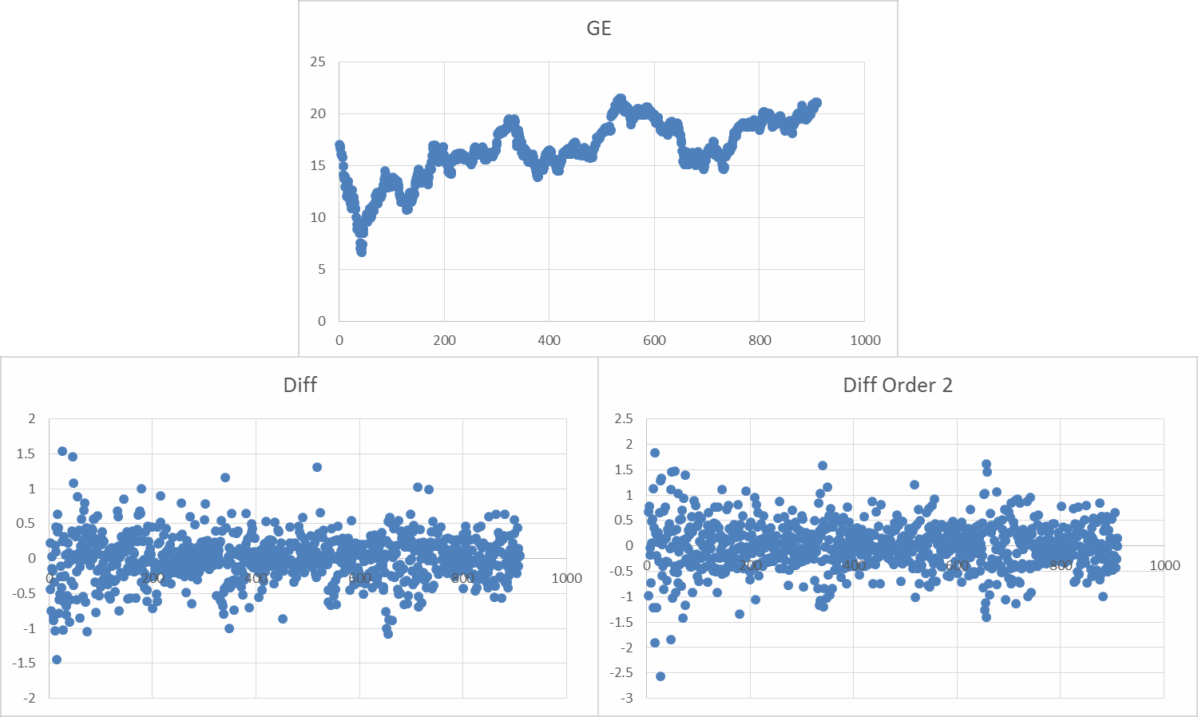
Removing Trend
03
Notes:
To forecast it is good to have stationary than to have trend in it
To explain things more than just trend then it is good to remove trend and see the remaining data and forecast

Slide 35
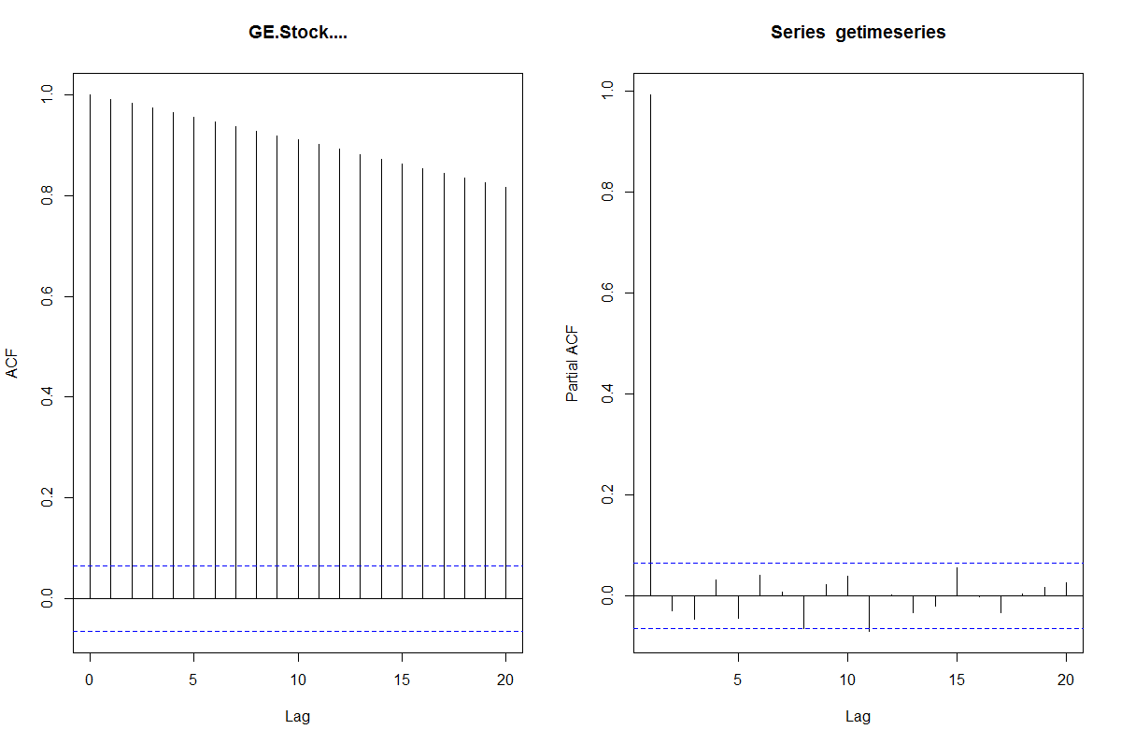
ACF and PACF of Stationary and Non-Stationary
Price of GE stock is highly correlated with the previous day’s value.
03
Notes:
This is acf pacf with trend i

Slide 36
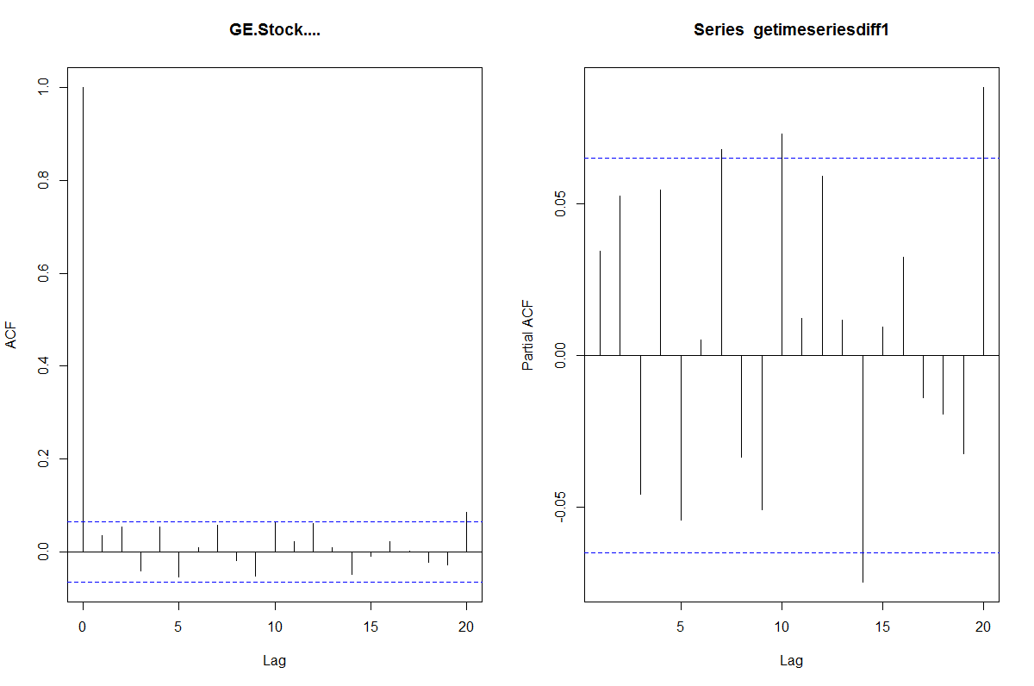
ACF and PACF of Stationary and Non-Stationary
Daily changes in GE stock price are essentially random.
03
Notes:
This is without trend

Slide 37
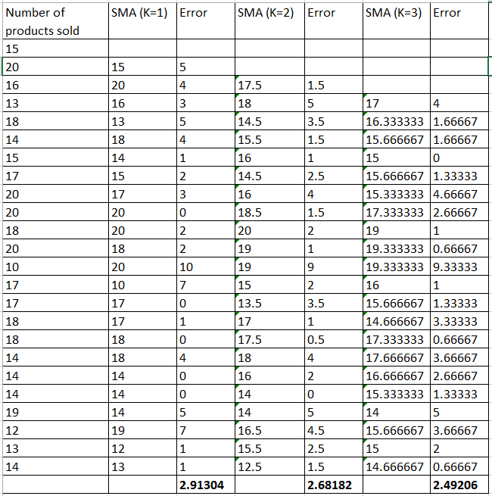
Stationary Model: Moving Averages
03
Notes:
To forecast it is good to have stationary than to have trend in it
To explain things more than just trend then it is good to remove trend and see the remaining data and forecast

Slide 38
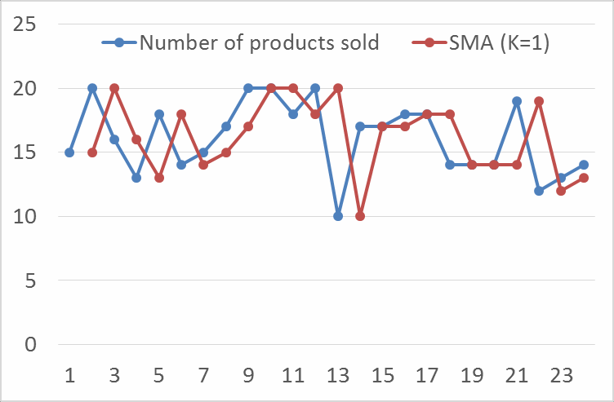
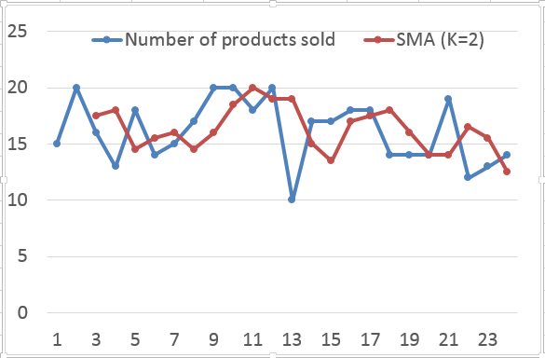
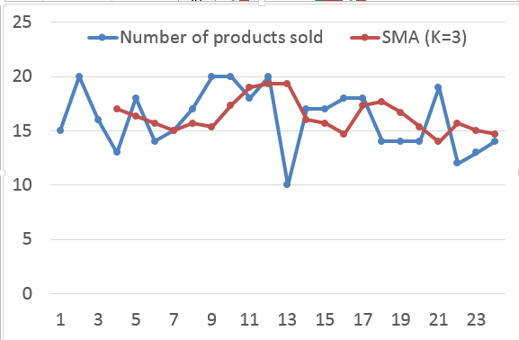
Stationary Model: Moving Averages
03
Notes:
As k increases the noise gets averaged out and gets smoothened

Slide 39
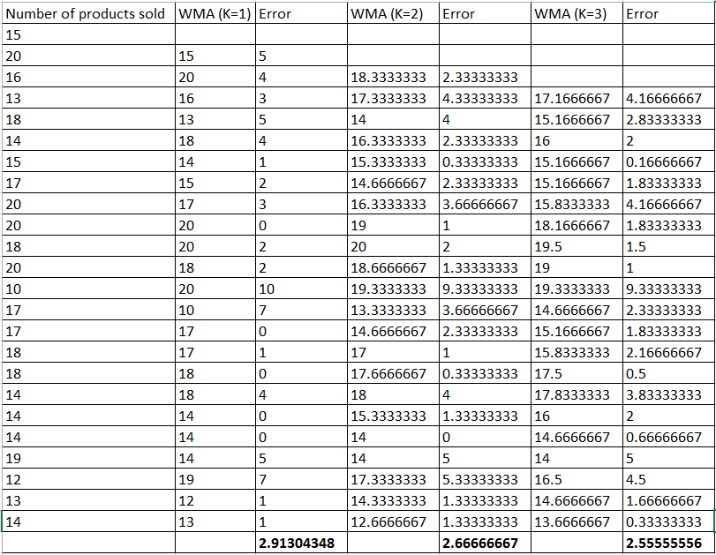
Stationary Model: Weighted Moving Averages
^{𝑌} 𝑡+1 ^{= 𝑤}1^{𝑌}𝑡 ^{+ 𝑤}2^{𝑌}𝑡−1 ^{+ ⋯ + 𝑤}𝑘^{𝑌}𝑡−𝑘+1
Typically we choose a time period of moving average and weights are chosen such that the error is minimized
03
Notes:
As k increases the noise gets averaged out and gets smoothened

Slide 40
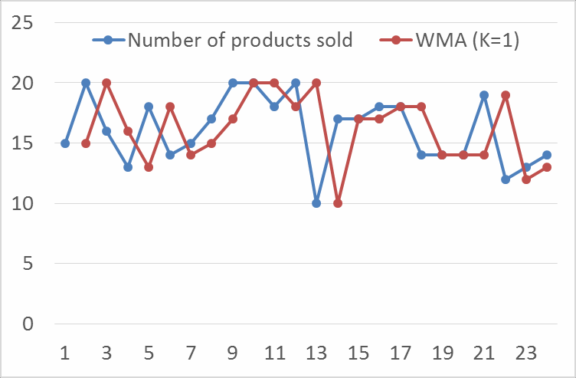
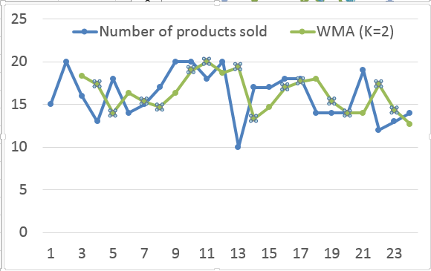
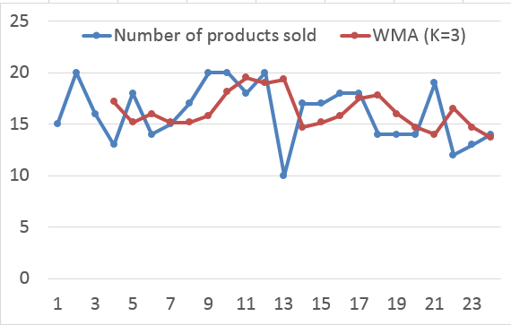
Stationary Model: Weighted Moving Averages
03
Notes:
As k increases the noise gets averaged out and gets smoothened

Slide 41
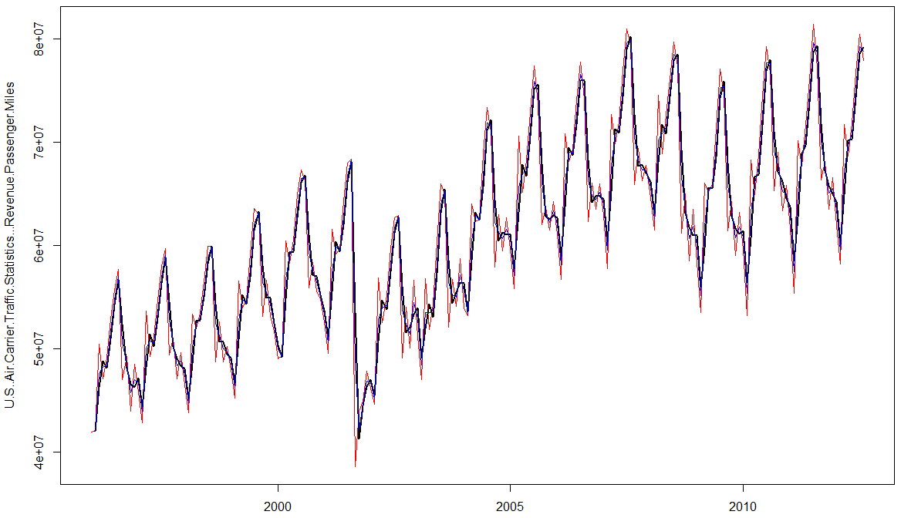
SMA and WMA – Revenue Passenger
MAPE-SMA : 4.09 MAPE-WMA: 2.72
03
Notes:
As k increases the noise gets averaged out and gets smoothened

Slide 42
Exponential Smoothing
Averaging over long periods dampens fluctuations, removing not only the noise but also trend and seasonality.
Moving averages over short recent periods maintains trend and seasonality but determining an optimum number for periods is tricky, even when using metrics like MAE.If averaged over too few periods, irregularities continue to remain and if averaged over long periods, dampening again becomes a problem.
Exponential smoothing retains all older periods while giving a greater weight to more recent periods (hence not a MOVING average).
Caution: It doesn’t make any one method superior for all situations.
03
Notes:
Average for long window will loose the structure of data
EMA takes the previous forecast and the error you made in previous adds by a scaling factor and says it is the new forecast..

Slide 43
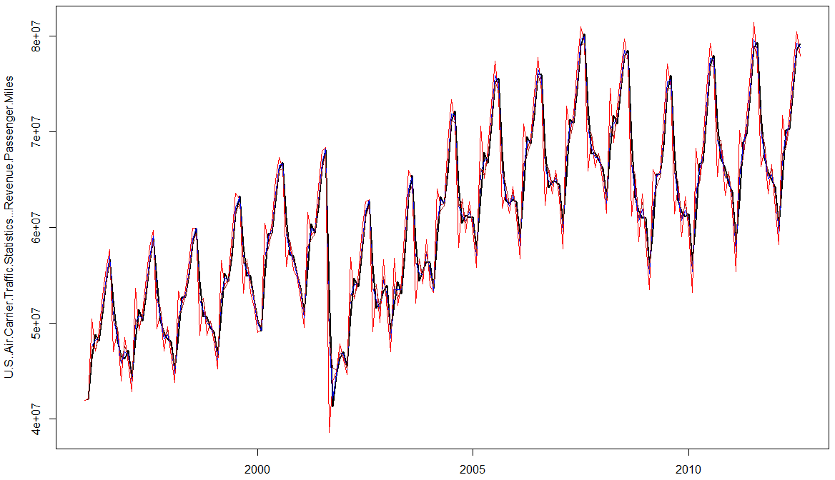
SMA and WMA – Revenue Passenger
MAPE-SMA : 4.09 MAPE-WMA: 2.72 MAPE-EMA: 2.54
03
Notes:
As k increases the noise gets averaged out and gets smoothened

Slide 44
Holt-Winters Method
This method separates the forecast into 3 components – Base Level + Trend
+ Seasonal
It updates each of the level using a Exponential smoothing with a different smoothing factor.
The algorithm computes the best possible smoothing factors based on the given data and does subsequent predictions using fitted smoothing constants.
03
Notes:
As k increases the noise gets averaged out and gets smoothened

Slide 45
Holt-Winters Method
3 components – Trend (T), Seasonality(S) and Base Level/Expectation(E).
3 weights – smoothing parameters – are used to update components at each
period.
Initial values for Base Level/Expectation and trend components are
obtained using linear regression on time.
Initial values for seasonal component are obtained from a dummy variable regression using de-trended data.
In the Expectation equation, the series is seasonally adjusted by subtracting the seasonal component.
03
Notes:
As k increases the noise gets averaged out and gets smoothened

Slide 46
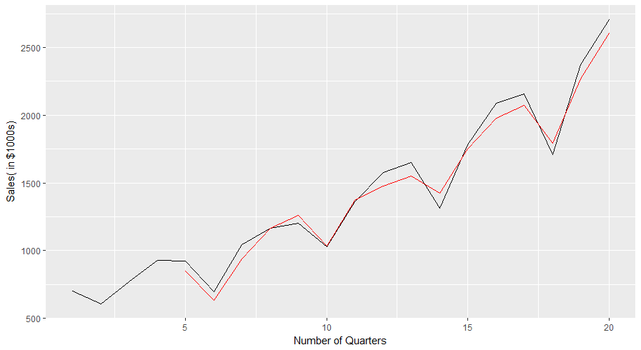
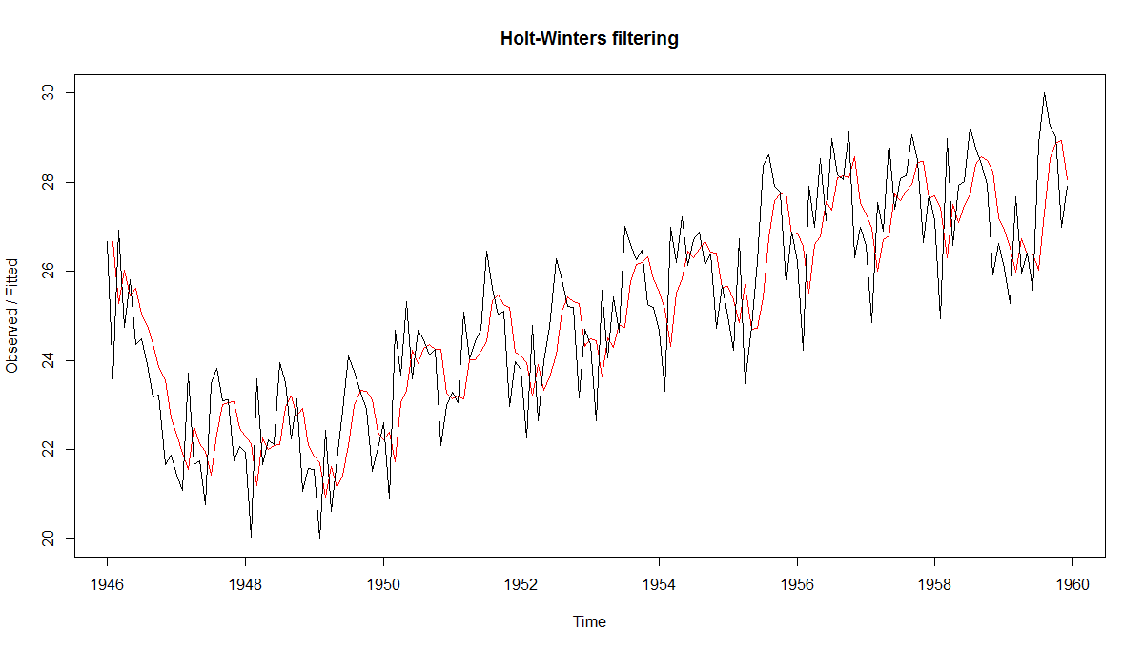
Holt-Winters Additive Seasonality
SSE = 103627
SSE = 281.43
03
Notes:
As k increases the noise gets averaged out and gets smoothened

Slide 47
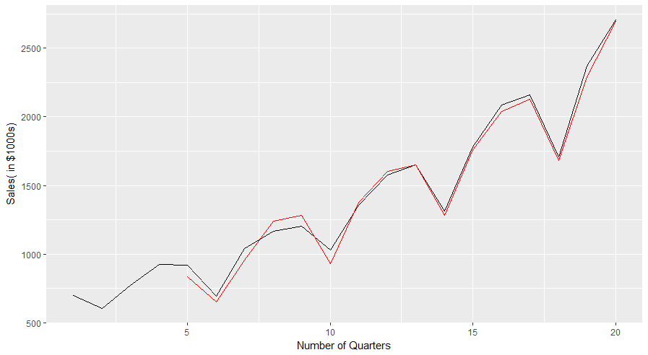
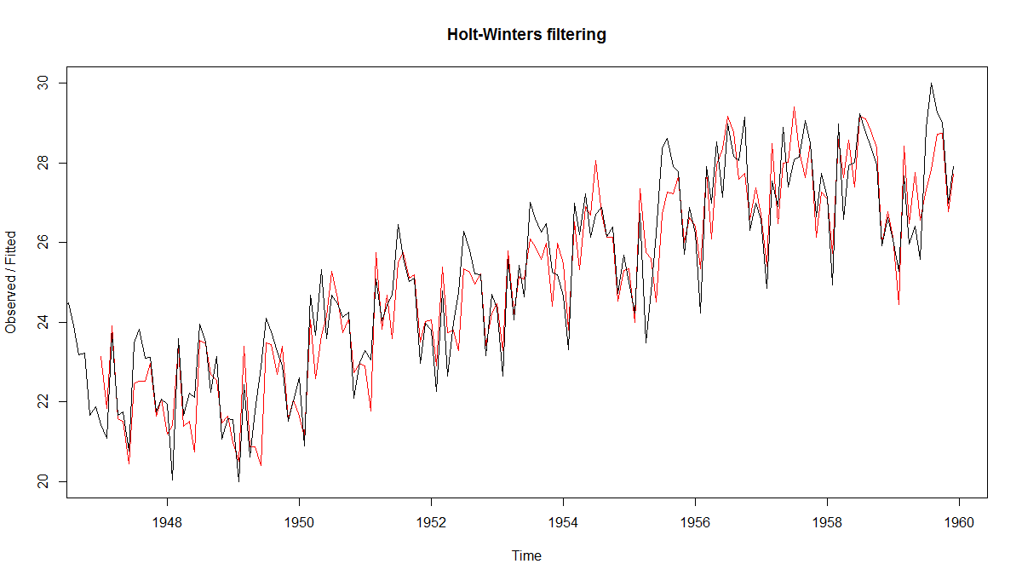
Holt-Winters Multiplicative Seasonality
SSE = 49816
SSE = 90.94
03
Notes:
Y(t+!) = alpha*seasonality + beta*trend + gamma*error
This is ultimately linear

Slide 48
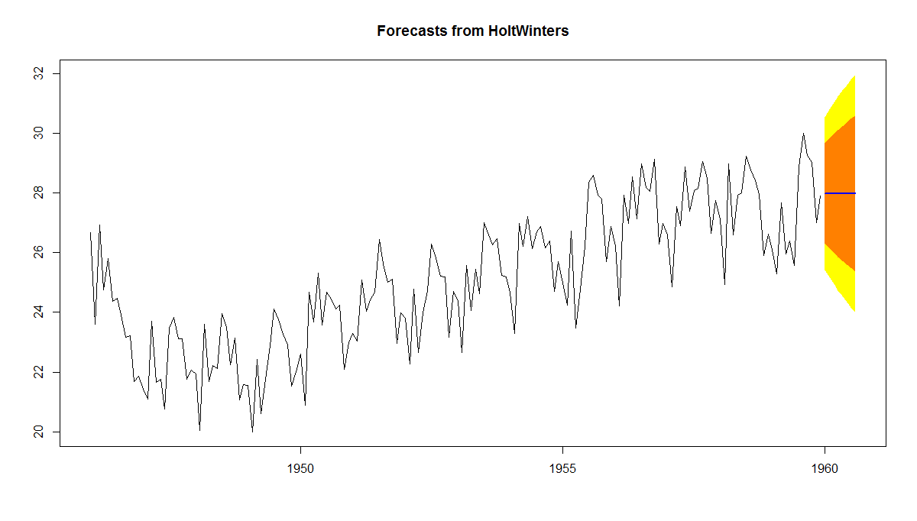
Holt-Winters: No trend and no seasonality
03
Notes:
Real world forecast = y(T+1) = a1*y(T) + a2*Y(T-1) + a3*Y(T-2)……..+ an
This is ARIMA MODEL
How many terms you need to forecast you use ACF and PACF

Slide 49
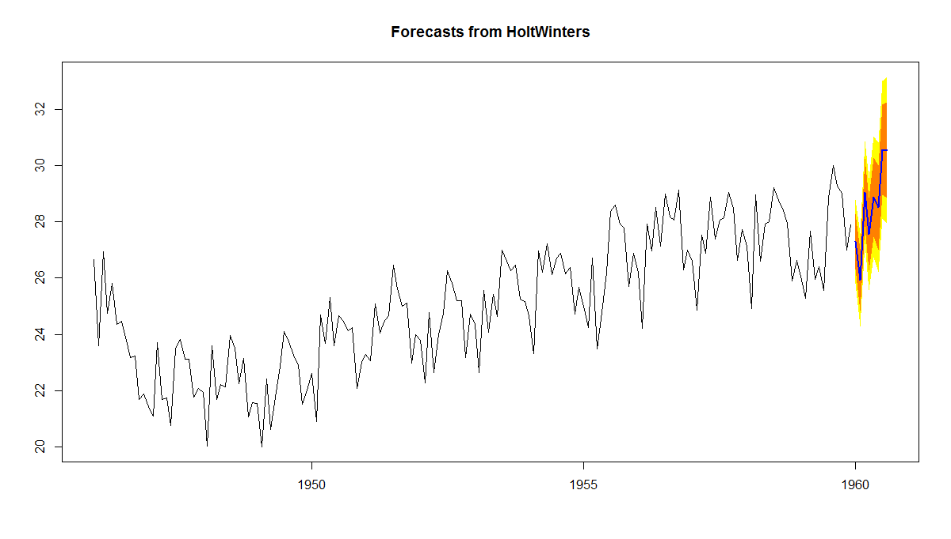
Holt-Winters: Forecast
03
Notes:
Real world forecast = y(T+1) = a1*y(T) + a2*Y(T-1) + a3*Y(T-2)……..+ an
This is ARIMA MODEL
How many terms you need to forecast you use ACF and PACF

Slide 50
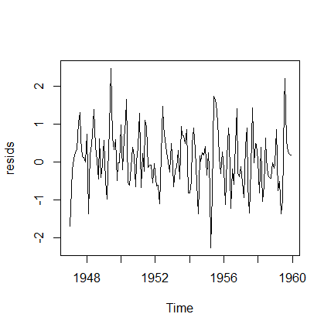
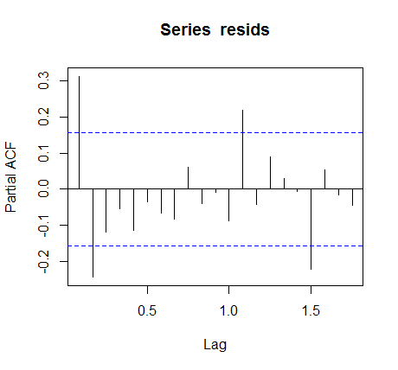
Residual Plots
03
Notes:
Real world forecast = y(T+1) = a1*y(T) + a2*Y(T-1) + a3*Y(T-2)……..+ an
This is ARIMA MODEL
How many terms you need to forecast you use ACF and PACF

Slide 51
AR(p)
Auto-regressive model of order p
𝑦 _{𝑡} = α + 𝛽₁ 𝑦_{𝑡−1} + 𝛽₂𝑦_{𝑡−2} + ⋯ + 𝛽_{𝑝}𝑦_{𝑡−𝑝}
We find the best value of parameters (𝛽₁ , 𝛽₂ ,…) that minimize the errors in forecast of 𝑦 _{𝑡}
The order of the model p is determined based on the number beyond which PACF terms are zero.
03
Notes:
Use past data to figure the best co-efficient to minimize the error
How to determine how many terms you need we use PACF plots..

Slide 52
Moving Average Models
Model attempts to predict future values using past
error in predictions 𝜀₁ =𝑦 ₁- 𝑦₁
So MA(2) model is
𝑦 _{𝑡} = 𝜇 + 𝜙₁𝜀_{𝑡−1} + 𝜙₂𝜀_{𝑡−2}
Where, 𝜇 is the average value of the time series
Again, the parameters (𝜙₁ , 𝜙₂) are determined so that prediction error is minimized.
The number of terms, q, is determined from the ACF plot. Its the maximum lag beyond which the ACF is 0
03
Notes:
When you have stationary data and you figure out how much error you are making and then keep adjusting is what MA does
Forecast for future is equal to average of data set + fn of most recent error + second most error
MA 2 takes two errors
MA4 takes four errors
Find best
@1 and @2 that minimizes the error

Slide 53
ARIMA
p is the number of autoregressive terms (a linear regression of the current value of the series against one or more prior values of the series)
– Maximum lag beyond which PACF is 0
d is the number of non-seasonal differences (order of the differencing) used to make the time series stationary
q is the number of past prediction error terms used for the future forecasts.
03

Slide 54
ARIMA
The number of parameters (p,d,q) needed to fit,
depends on the dataset
There are techniques that automate model
selection
auto.Arima command in R picks the best p,d & q parameters for ARIMA(p,d,q)
03

Slide 55
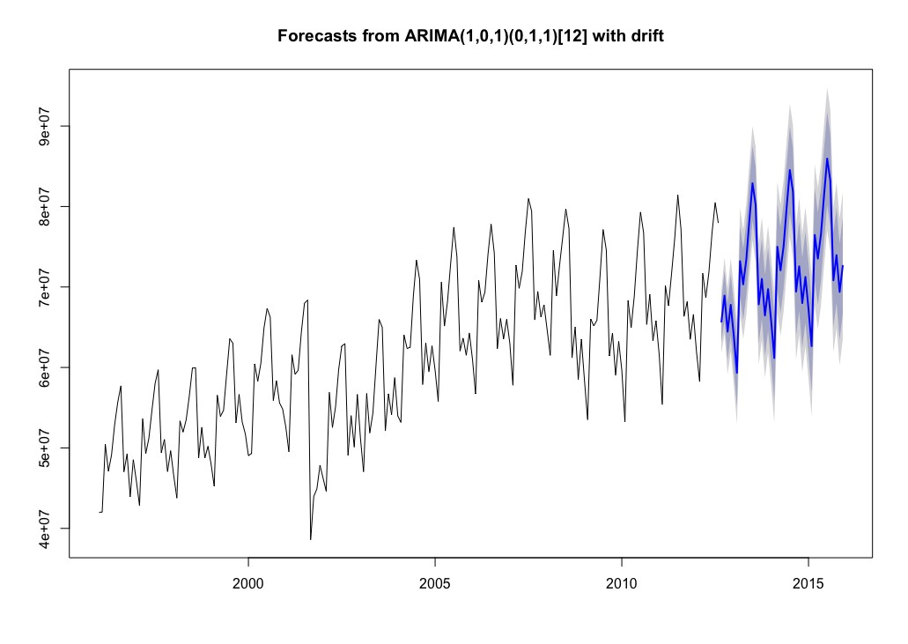
ARIMA on RPM
MAPE: 1.65%
03

Slide 56

Holt-Winter on RPM
MAPE: 1.45%
03

Slide 57

Conclusion
"Prediction is very difficult, especially if it's about the future."
--Niels Bohr, Nobel laureate in Physics
03

